Slide 1
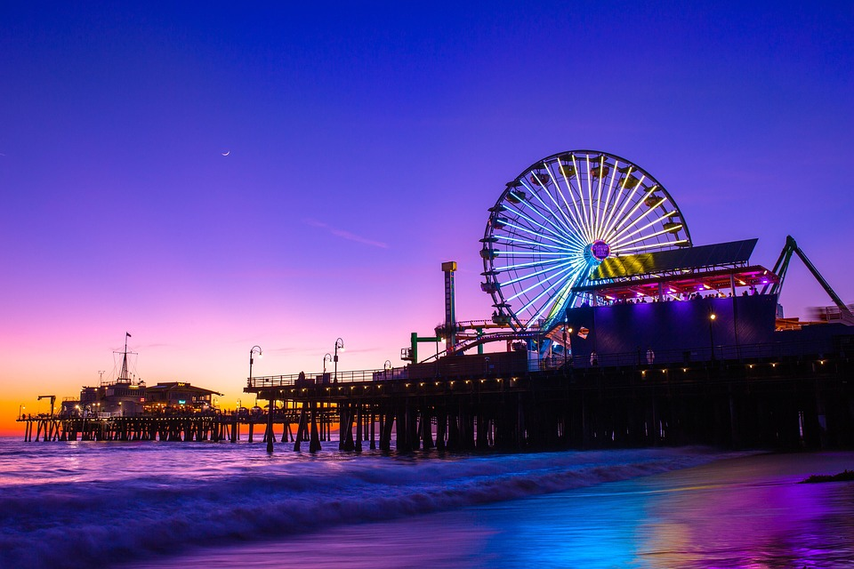
AMUSEMENT PARK
1.Introduction
2.DB Diagram
3.Modules with brief details
4.Output
5.Conclusion

Slide 2
INTRODUCTION
The project is about amusement park. Project contain details of facilities available , ambience of park i.e. different shows and games available in different areas and timings and also the details of resorts available in the park. All the details can be accessed easily so that it will aid a stranger and anybody can easily acquaint about the whole park
The project gives the details of the park timings, offers available for ticket booking ,food available and it’s cost, games and certain shows timings, resorts and details of it and also online ticket booking facility.
If visitors lost any valuable things then they can acquaint whether the lost thing is found or not through park’s website.

Slide 3
DATABASE TABLE
SIGN-UP | LOST AND FOUND | TICKET BOOKING
User id(PK) | Object id(PK) | Complete name
Name | Object name | Number of children
Email address | Object type/company | Number of adults
Phone number | Object color | Number of senior citizens
Password | Found date | Mode of payment
 |  | Booking date
 |  | Month
 |  | Year
 |  | Food name
 |  | Quantity
 |  | Booking id(PK)

Slide 4
MODULES
SIGN UP : It contains name, where name can be user or admin and then email address, phone number and password.
LOGIN: The person who has already signed up can be login in with same username and password.
TICKET BOOKING: The number of children, adults, senior citizens and mode of payment needed to be mentioned. If food is needed then it has to be entered. Then total cost will be displayed. Ticket will be booked only after successful login.
ADMIN : In this module Admin user can manage other users, bookings and their respected billings.
LOST AND FOUND :In this module Admin user can add the lost things which they found in the park and visitor who has lost it can check it through park’s website ,Whether the lost thing is found or not can be known by the visitor.

Slide 5
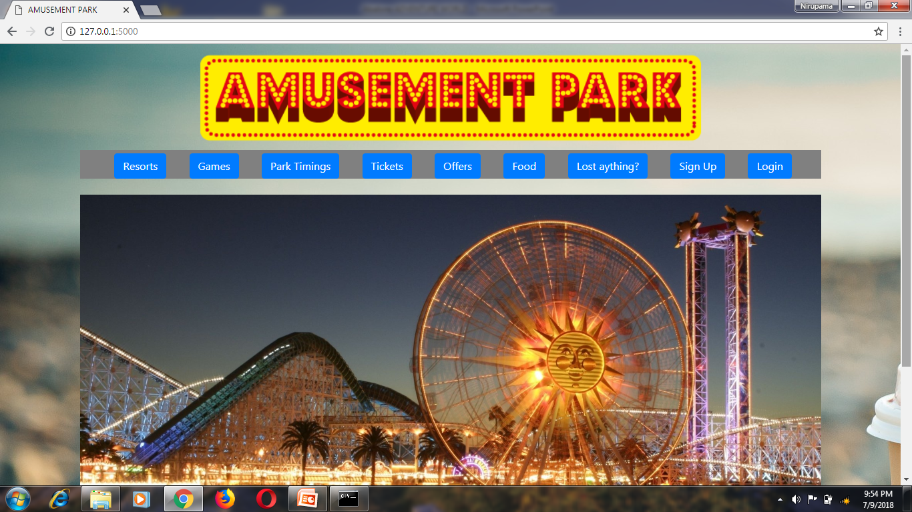
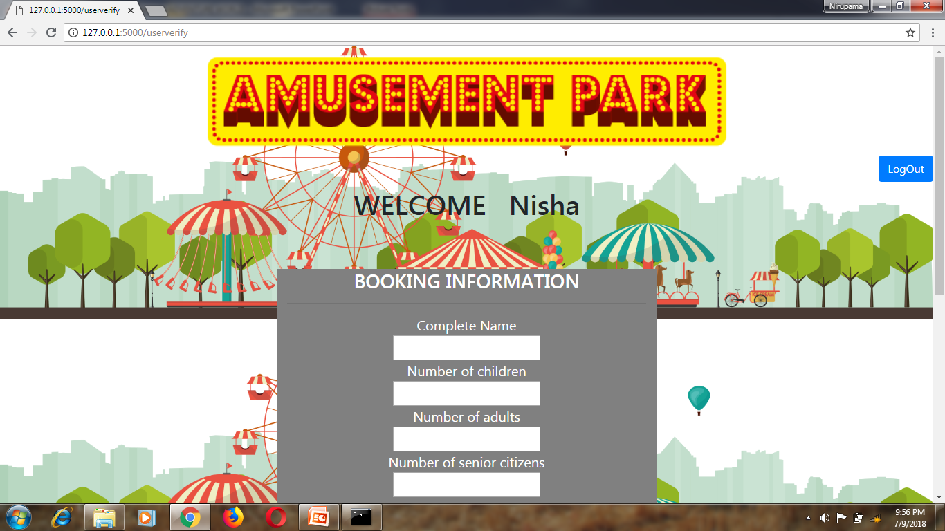
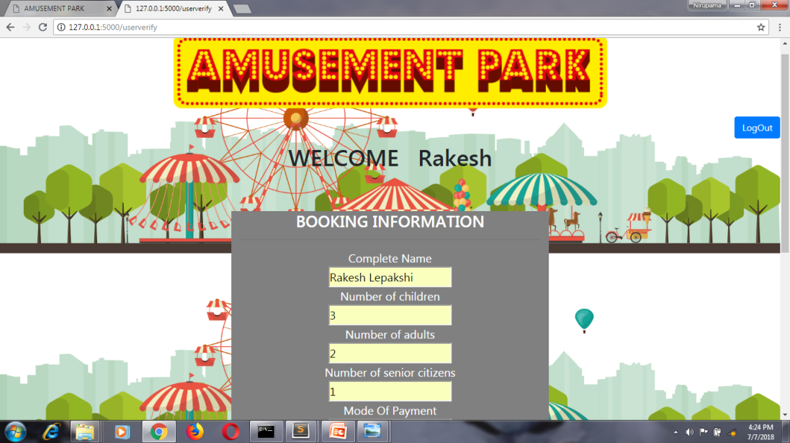
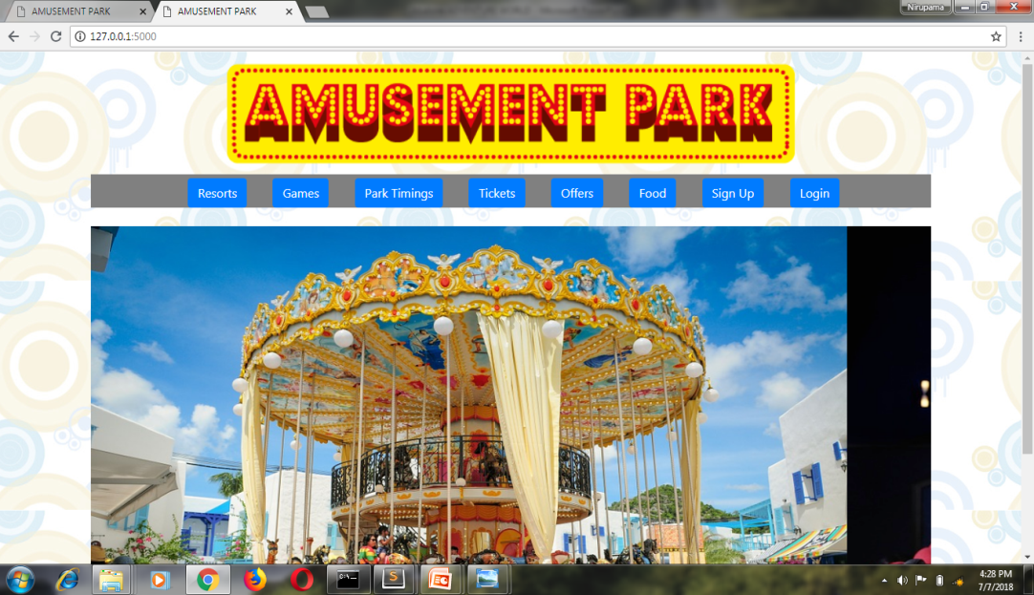
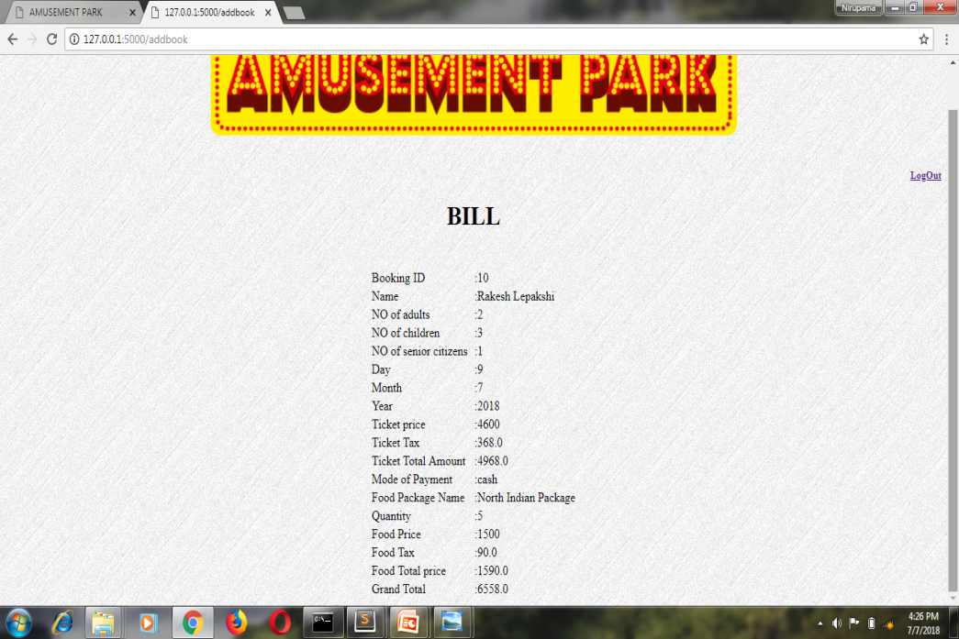
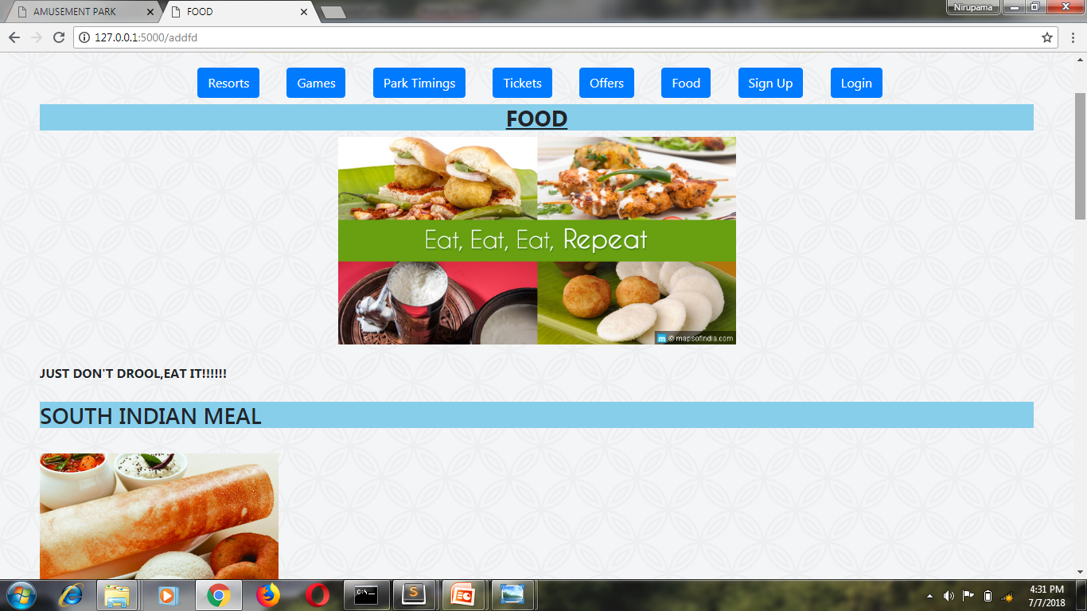
OUTPUT

Slide 6
CONCLUSION
This project helps the visitors who have not acquaint about amusement park details. The main aim of the project is to give complete details of the park, like games, resorts, ticket price, timings of park, food details, tickets can also be booked. If visitor lost any valuable things then he can visit the park’s website to know about it. Hence it helps the visitors to know about the park completely.

Slide 7
Thank you

Slide 8
GROUP 4
Group leader – Sushmitha R 1SI16IS056
Group members – Nirupama 1SI16IS035
Nagatheju T V 1SI16IS034
Gunasheela B G 1SI16IS019
Pavana raju 1SI16IS039

